Slide 1
Lending Club Case Study
Vineet Tiwari

Slide 2
Business CASE UNDERSTANDING
A business case for loan data analysis involves presenting a compelling argument for utilizing data analysis techniques to make informed decisions about lending practices.
Every time they receive a loan application, the company's goal is to decide whether to approve or deny it based on a number of factors.
Identify the specific challenges or opportunities in the lending process that necessitate data analysis.

Slide 3
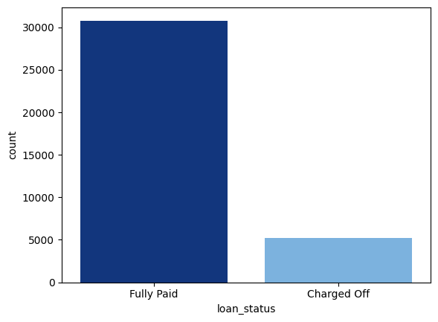
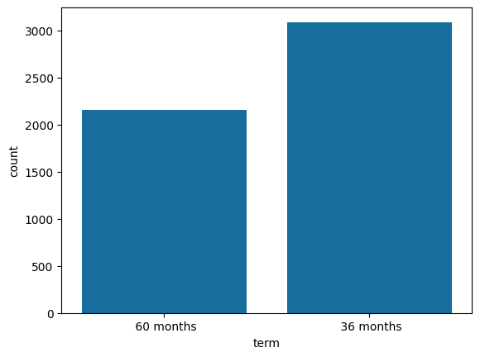
Loan Status and terms count

Slide 4
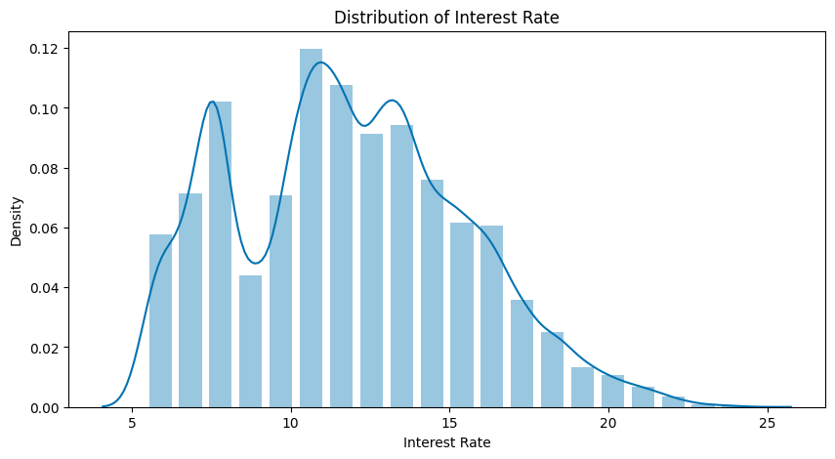
Interest rate distributions
Interest Rate: The count of loan taken varies with interest rate showing peak around in 5-15 bracket and decreasing slowly where as the chance of defaulting increases with interest rate.

Slide 5
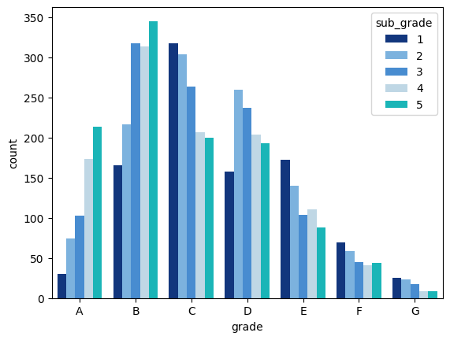
GRADE STATUS
Grade: Due to their low risk and thus low default likelihood, the majority of the granted loans get higher grades. 60 month term loans have larger number of lower grade loans with high risk.
Sub Grade: This gives more information on how the loans within a grade are more heavily weighted toward lower sub grades.

Slide 6
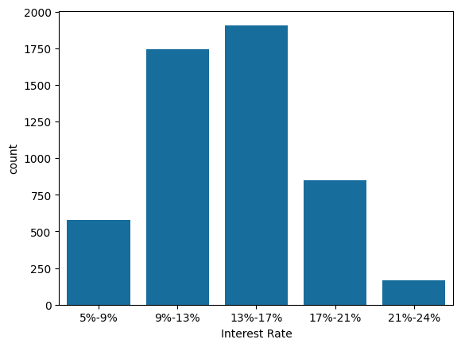
Interest rate section
Interest rates are higher between 13% - 17%

Slide 7
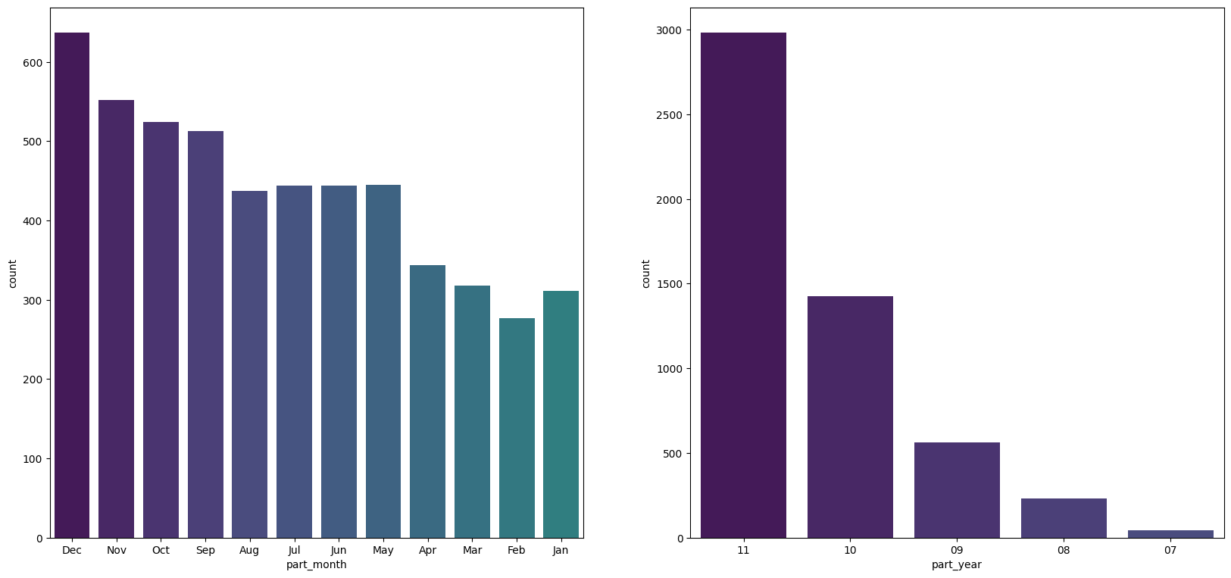
Loan status month and yearly
Most loan are paid off in December and year 2011 was most loans paid off

Slide 8
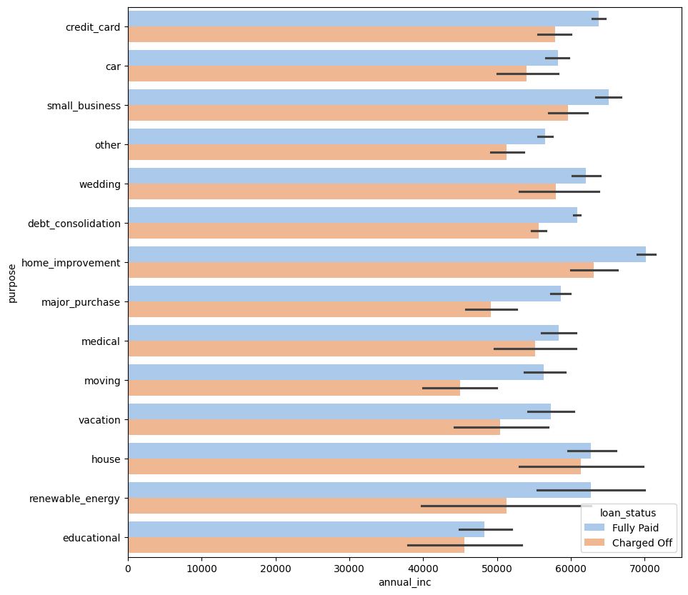
Annual income vs purpose
Home improvement has highest annual income and the loan is fully paid off

Slide 9
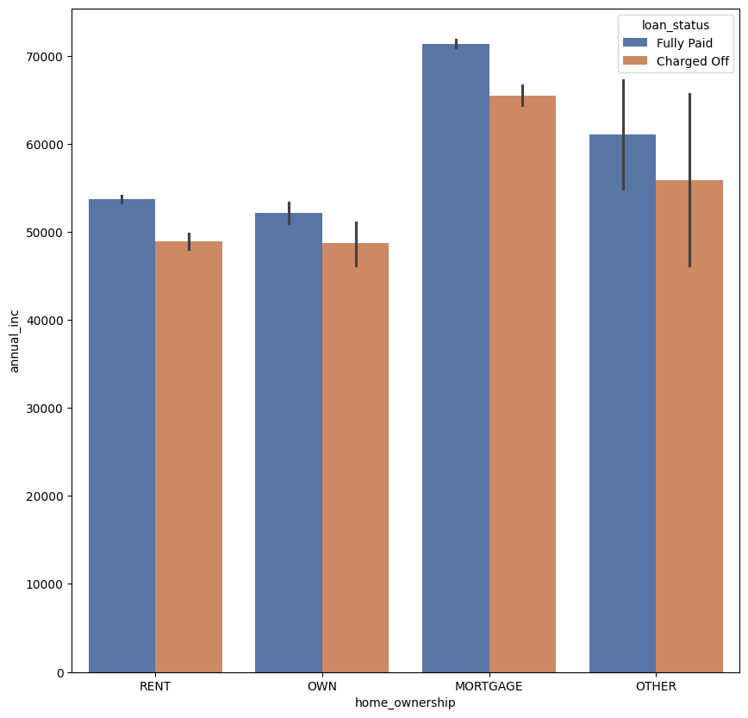
Loan status for home ownership
Mortgage is highest with highest icome

Slide 10
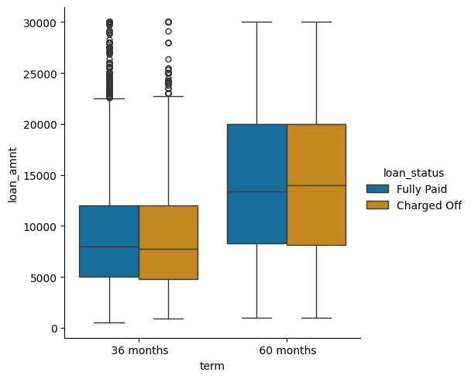
Terms vs loan amount
More loan amount with more term

Slide 11
Conclusion Analysis
Highest amount of loan have small business
2011 Year was with highest loan amount and with projection seen it will keep increasing yearly
Charged off and Fully paid loan are same for terms of loan period
Highest amount of interest rates is for loan amount to 30-35k
Grade G has highest fully paid loan amount
Rent has the lowest projection for the loan amount
Loan amount on house has highest annual income
Loan for 'home improvement' and have income of 60k -70k

